Slide 1
Emergency Department & Community Update
BCMS July 14, 2020
Christopher Sampson, MD, FACEP
Department of Emergency Medicine

Slide 3
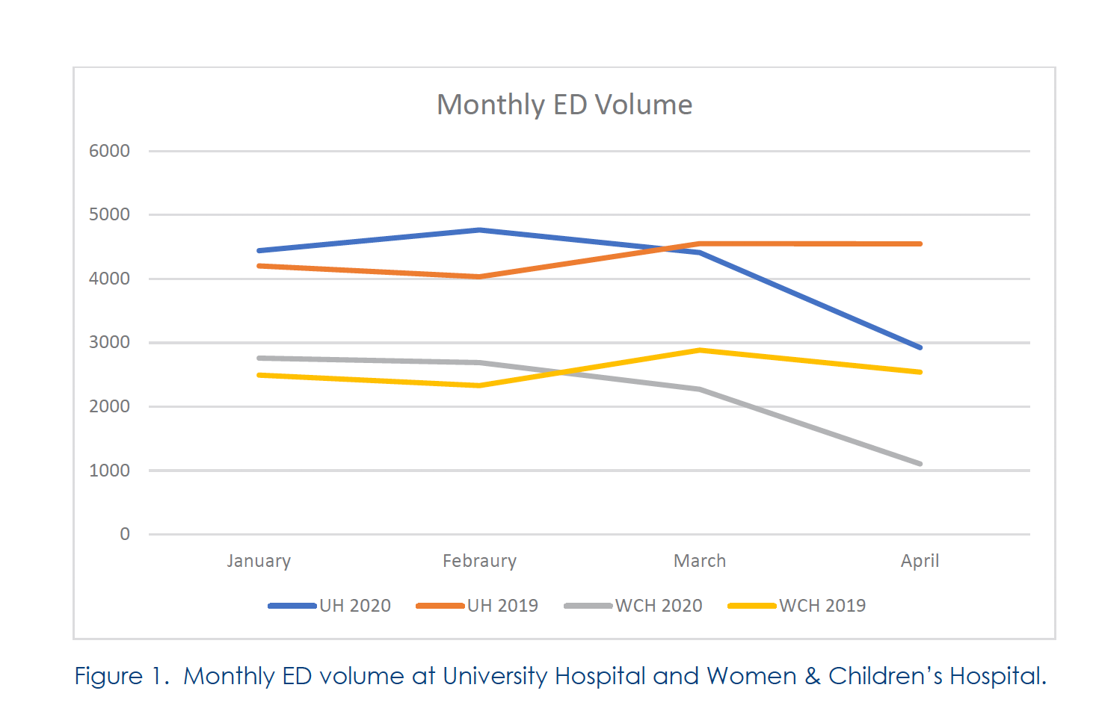

Slide 5
Notes:
weekly rates of hospitalization for acute myocardial infarction decreased by up to 48%

Slide 7
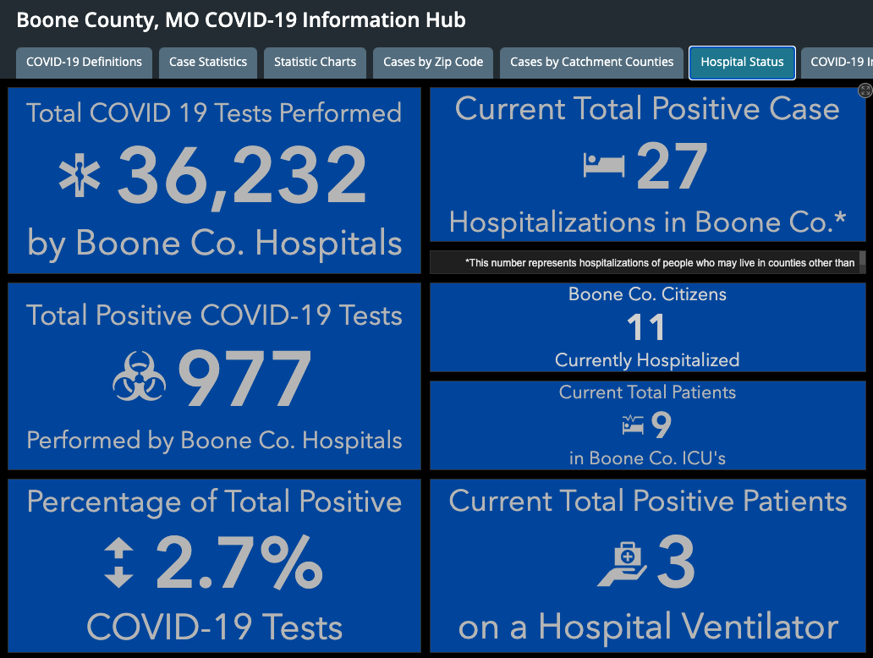
Notes:
18+
16 PUI

Slide 8
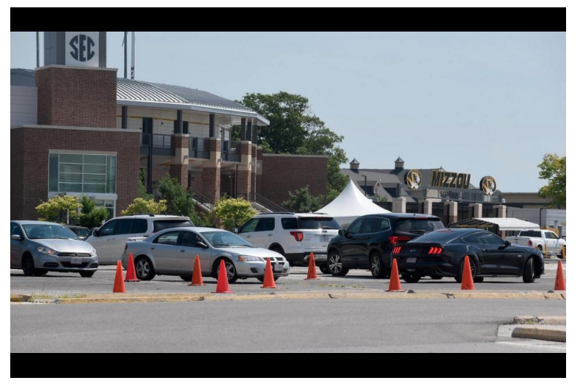
Notes:
week of June 29 ~300/day
650/day

Slide 12
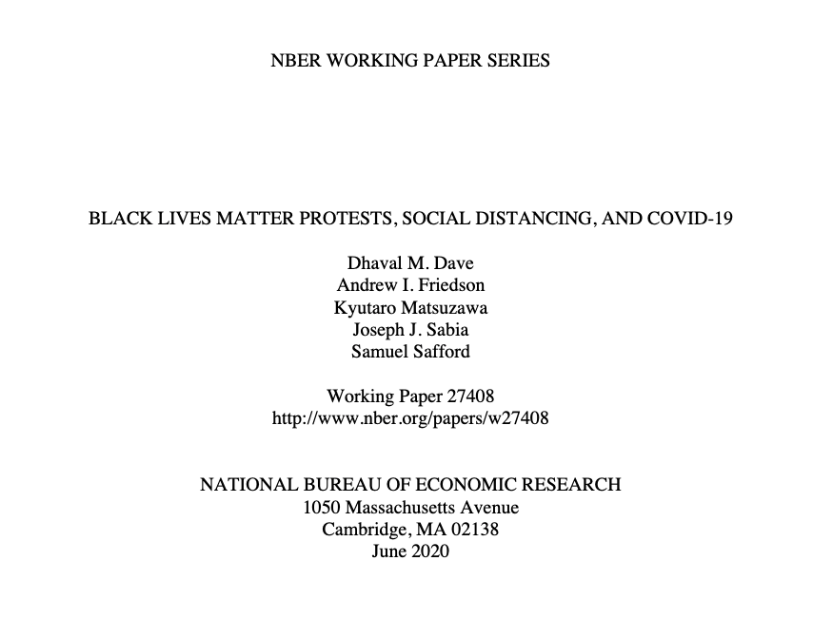

Slide 14
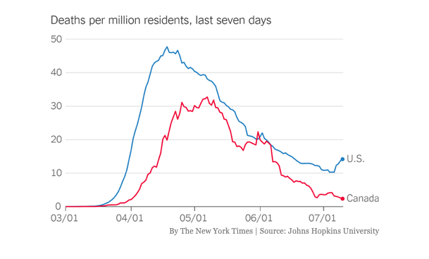

Slide 15
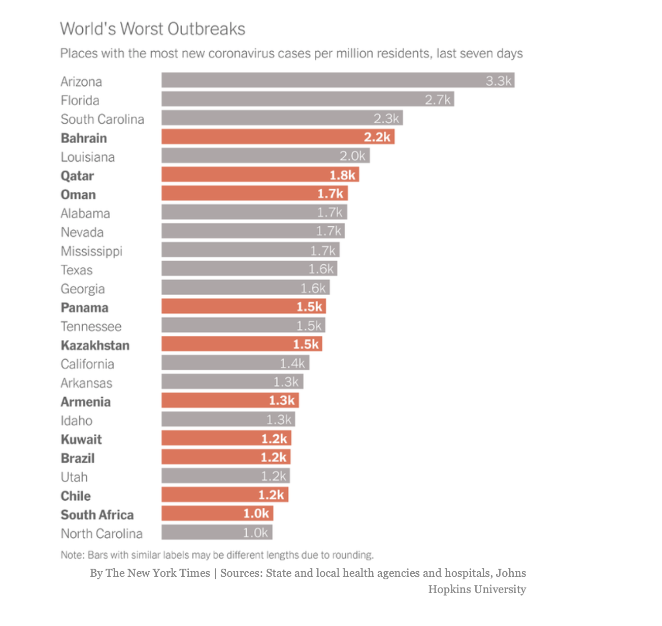

Slide 16
Age Adjusted Risk
0-24 <1 in 492,000
0-34 <1 in 151,540
35-54 ~1 in 10,681
54 and under 1 in 26,922
55-64 ~1 in 3034
65 and older ~1 in 553
MVC 1 in 4-8,000

Slide 18
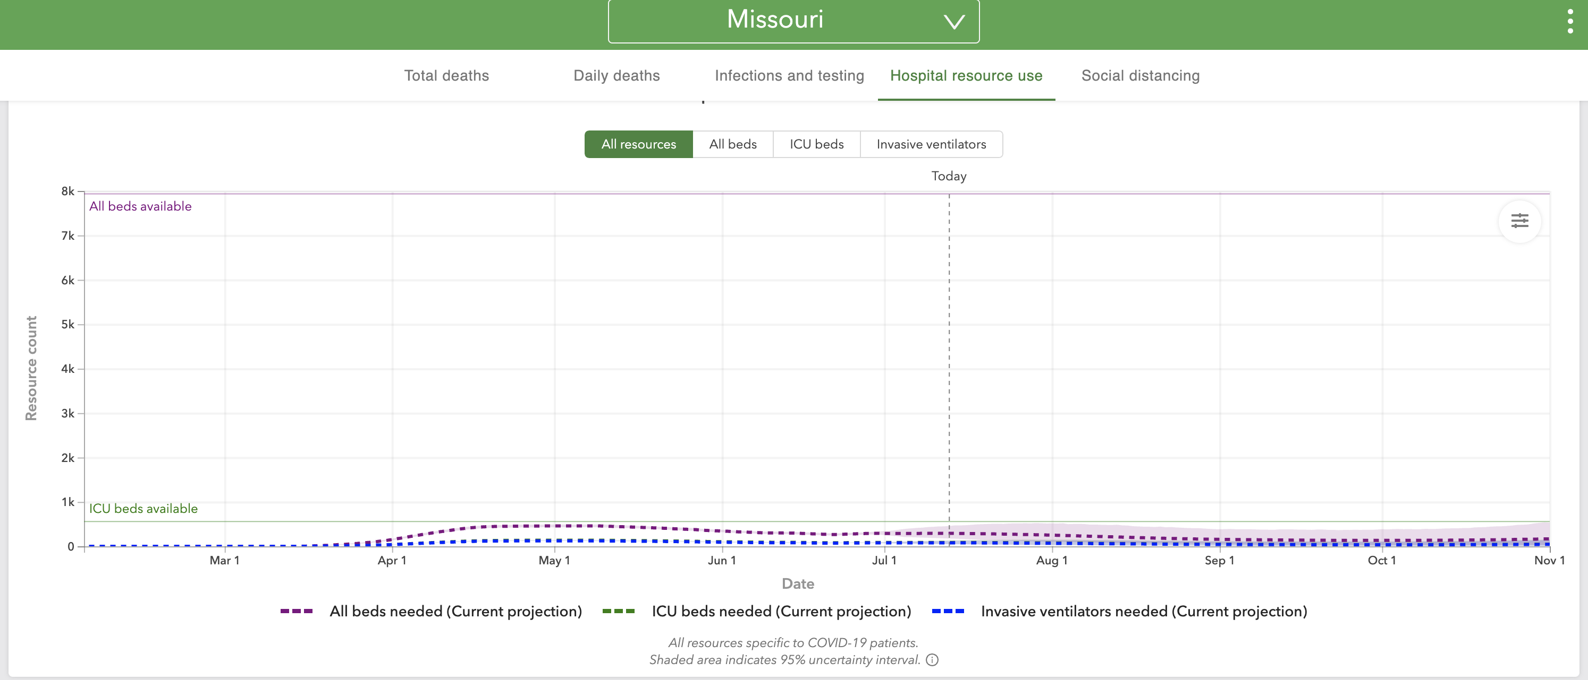

Slide 19
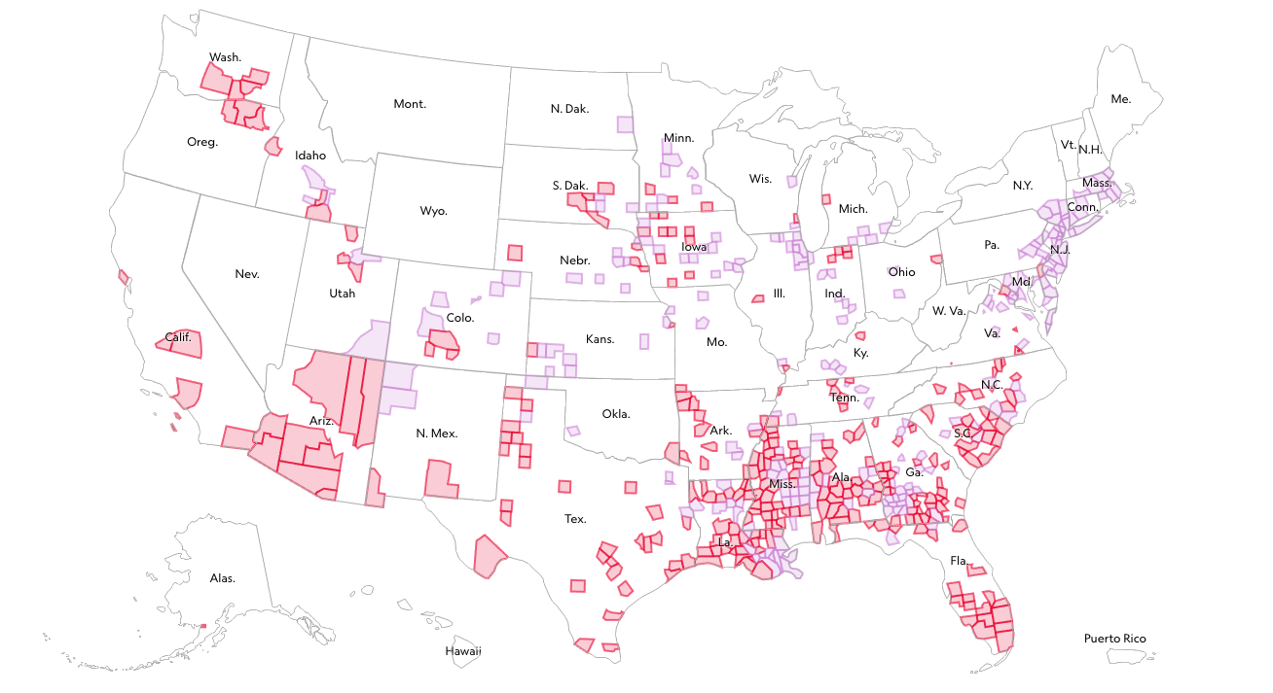
Notes:
(purple) 536 counties have case density rates worse than one in 100 people.
(red) 294 of them have also had their worst two-week period since June 1.
Saline, Suillvan, Buchanon

