Slide 1
MU Health Care Covid-19 Update
Taylor Nelson, DO
Assistant Professor of Clinical Medicine
Division of Infectious Diseases

Slide 2
Covid-19 at MUHC
MUHC / Missouri Covid-19 Overview
Changes at MU
Cases – my personal experience so far
Future research
Questions?

Slide 3
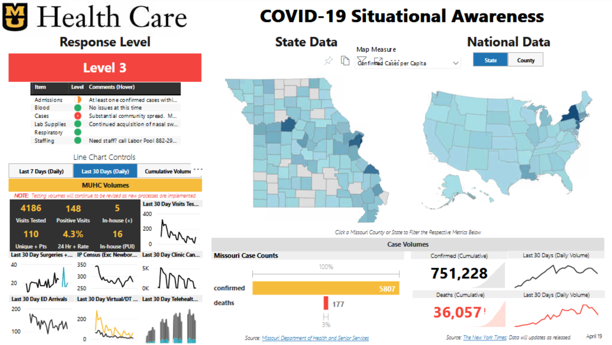

Slide 4
Take homes:
Quicker test turnaround
(new in house testing for MU)
Overall curves down-trending for positive cases and testing

Slide 5
Missouri
https://covid19.healthdata.org/united-states-of-america/missouri?fbclid=IwAR2BYtLRxgItTuheLns9j1_poaR0wTcZL3Z1KMZyemG_y9_-acGmpCGgEIU

Slide 6
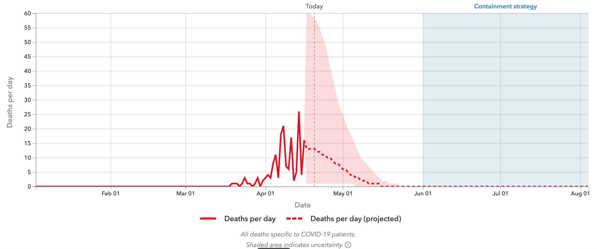
Based on IHME projection, relaxation of social distancing may be possible with containment strategies (testing, contact tracing, limiting crowd size) on June 1
https://covid19.healthdata.org/united-states-of-america/missouri?fbclid=IwAR2BYtLRxgItTuheLns9j1_poaR0wTcZL3Z1KMZyemG_y9_-acGmpCGgEIU

Slide 7
Recent Changes at MU
Drive-thru testing, change in hours – testing numbers declining
Monday – Friday 8:00 – 19:00
Saturday 8:00 – 12:00
Sunday closed
We are continually evaluating our resources and planning is in progress for a phased progression towards ”re-opening,” keeping in mind that returning to pre-Covid “normalcy” will not happen quickly
There is a learning curve and changes are frequent as we learn more about this novel infection and monitor case trends
Telehealth is growing substantially

Slide 8
A few cases from MU
Thank you to my colleague Hariharan Regunath for sharing some of these slides

Slide 9
Case 1
65 y/o male non-smoker
HTN, HLD, pre-diabetes; Meds: lisinopril, metoprolol, statin
Returned from Europe (unsure where) 3/15/20, upon arrival home developed fever 101.5’F, fatigue, weakness, myalgias, mild dry cough
Urgent care video visit 3/18/20 – drive thru testing returned positive on 3/19, patient informed 3/20, stable, no further action needed
3/21 worsening symptoms, admitted via ED

Slide 10
Case 1
Note from Columbia/Boone County Department of Public Health and Human Services:
This patient was diagnosed with COVID-19 infection on 3/18. He called the health dept today to ask advice for worsening symptoms. His fever is 101-102 with Tylenol. He is feeling very weak and also has developed some shortness of breath. He tells me he is having trouble even talking to me on the phone but he think that is mostly due to the severe weakness. He does not sound to be in acute respiratory distress by phone but I'm worried about his description of these worsening symptoms and I recommended evaluation. I called UH ER for specific directions on how to proceed. I then advised patient to go to UH ER, wear a mask if he has one, and call the ER directly when he arrives so they can come out to get him.

Slide 11
Case 1

Slide 12
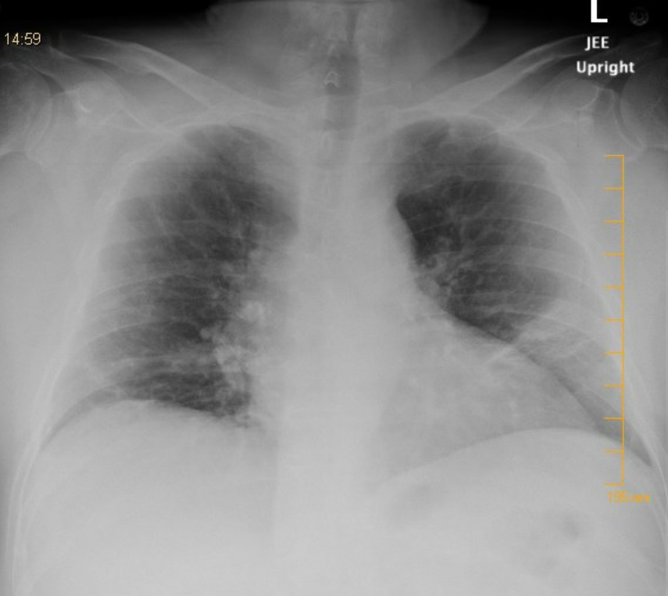
Case 1
IMPRESSION:
Right upper lobe Nonspecific bronchial wall
thickening, which can be seen in viral/atypical
infection versus reactive airway disease.
2. Patchy opacities are present in both lower lobes.
Radiographic findings are not specific nor sensitive
to changes associated with COVID 19 infection.

Slide 13
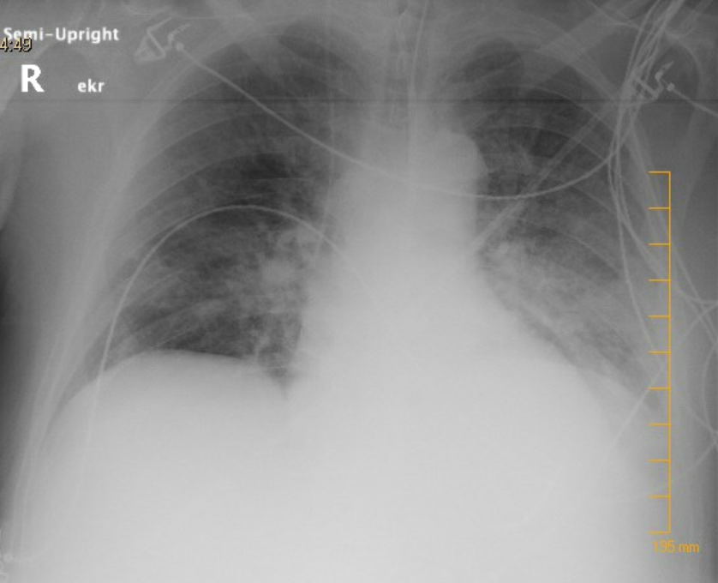
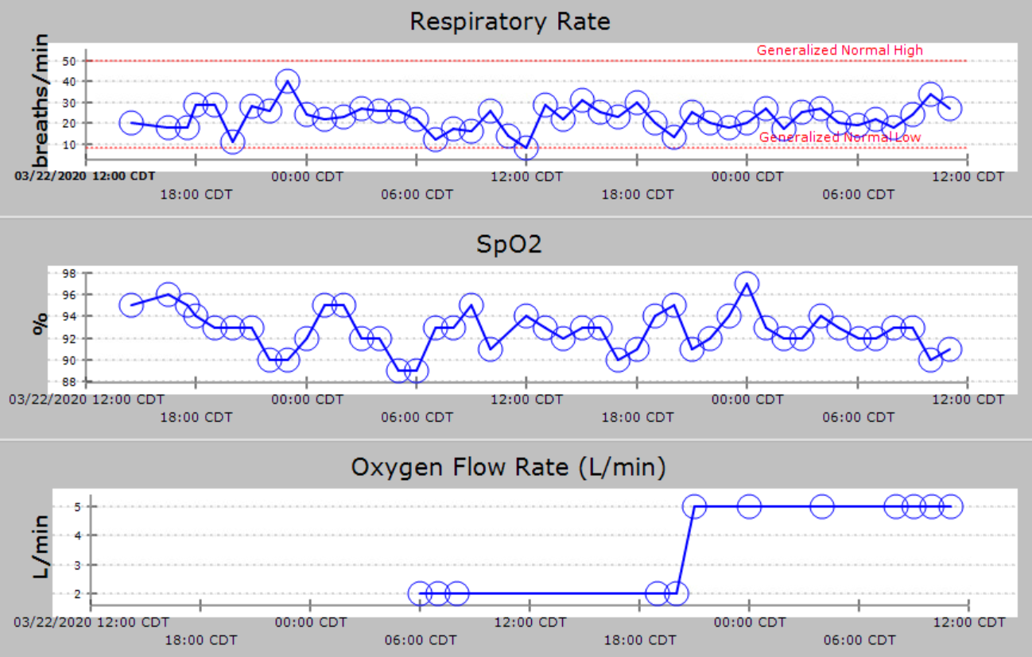
Case 1
Course
ID consulted night 1, resp PCR panel negative
Started hydroxychloroquine on admission
Day 3, subjectively more dyspneic

Slide 14
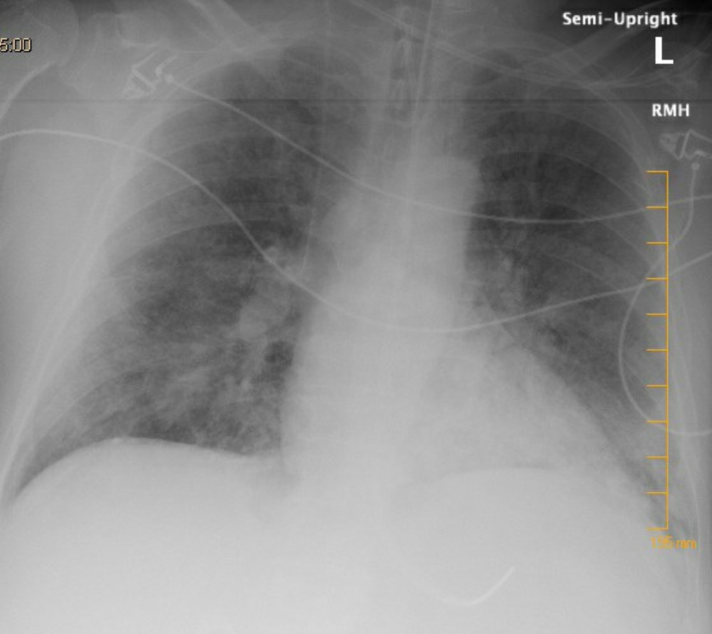
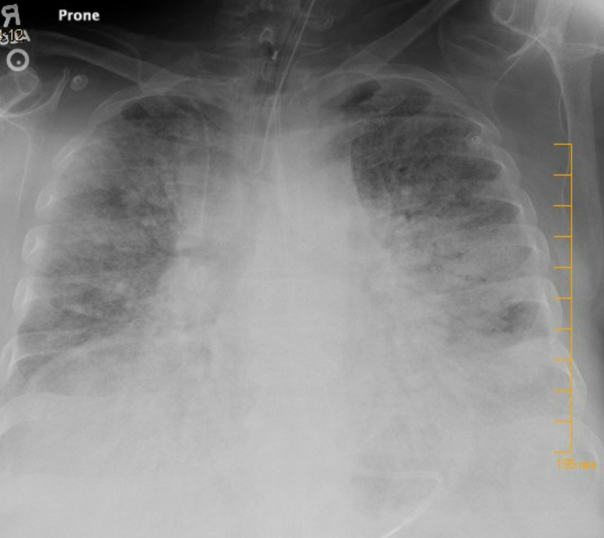
Case 1
Day 3 – RR increased to 35 breaths/min, requiring 8L O2
Electively intubated, sedated, paralyzed
End of week 1
Week 3

Slide 15
Case 1

Slide 16
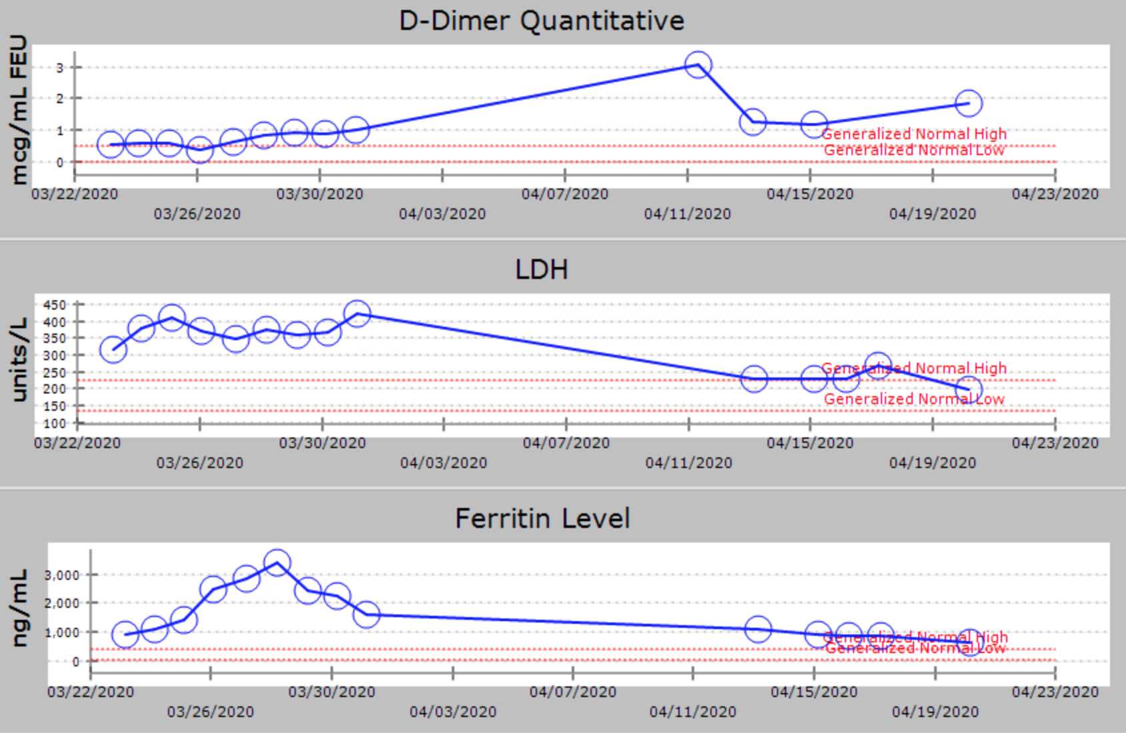
Case 1

Slide 17
Case 1
IL6 level = 72.8 pg/mL (normal < 1.8)
Nasopharyngeal swab remained positive as of 4/8/20

Slide 18
Case 1
Course
Required paralysis for several days initially
Intermittent proned ventilation, last on 4/16/20
Required vasopressors for a period of time related to infection / sedation
Developed MSSA VAP x 2, treated with ertapenem and again later with cefazolin
Ongoing encephalopathy
Remains intubated (since 3/24/20) on 70% FiO2 currently, paralyzed again
A fib with RVR requiring amiodarone (later in course)
Prognosis questionable, course up and down
Off sedation + gag reflex, not withdrawing to pain

Slide 19
Case 2
44 y/o male, history asthma
ED video visit 3/25/20, 5 day history fever, chills, dry cough, Covid testing positive
No travel history or known exposure history
Came to ED 3/26 with worsening dyspnea
Leukocytosis, lymphopenia, eosinopenia, mild transaminitis (< 2x ULN), CRP 20, fever 39.1’F, RR 19, on 4L O2
pH 7.167
Admitted to Covid ICU

Slide 20
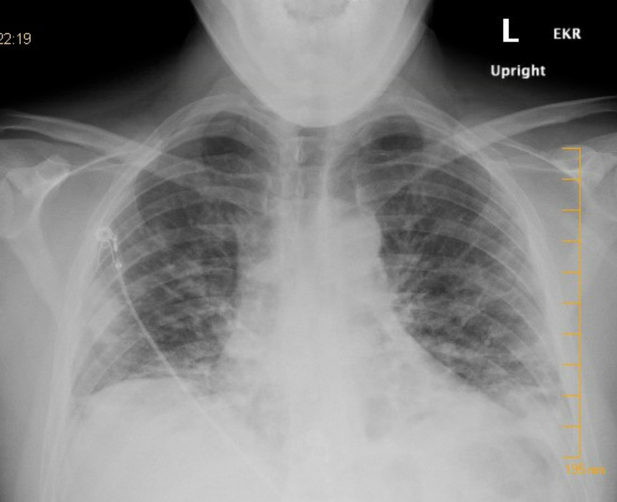
Case 2
IMPRESSION:
Findings of interstitial and alveolar edema
with scattered peripheral lower lobe
consolidations concerning for atypical viral
infection (including COVID-19).

Slide 21
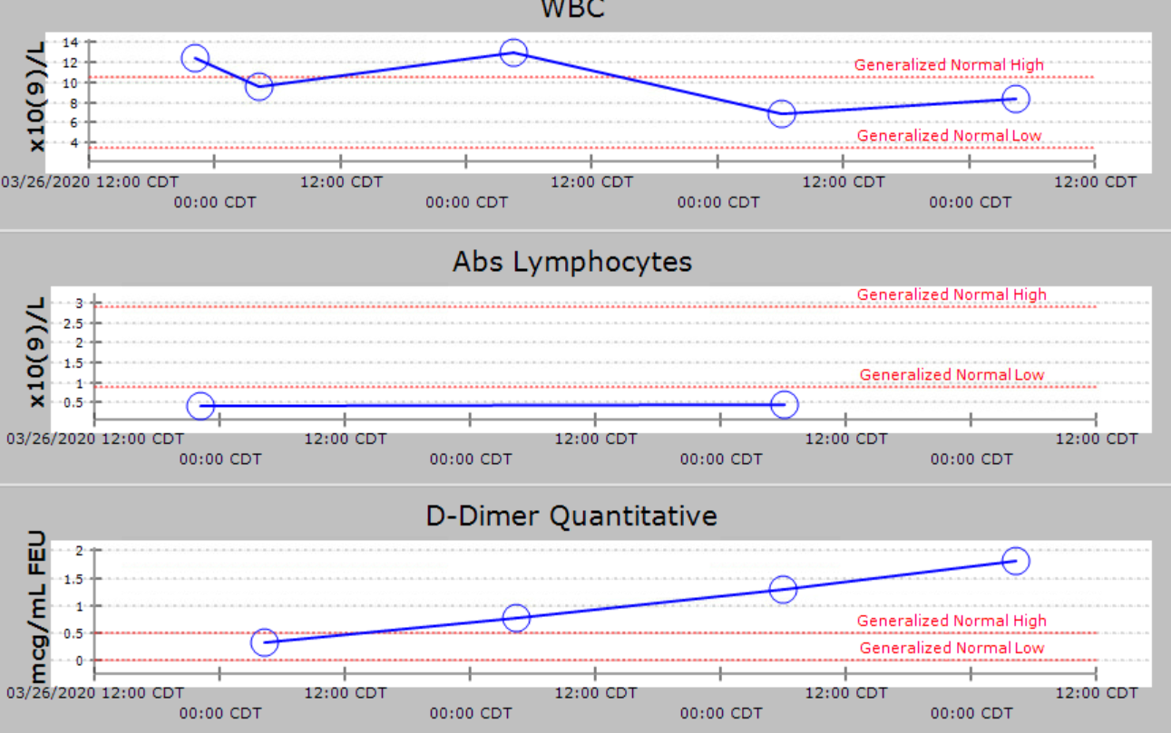
Case 2
Respiratory rate up to 32 ultimately requiring intubation on day 2

Slide 22
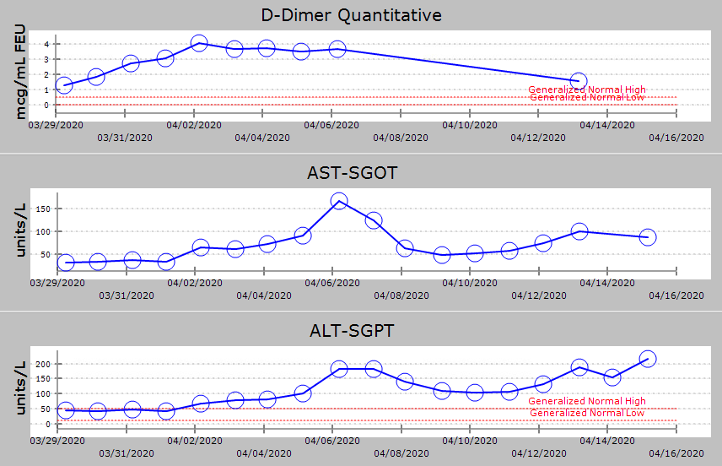
Case 2

Slide 23
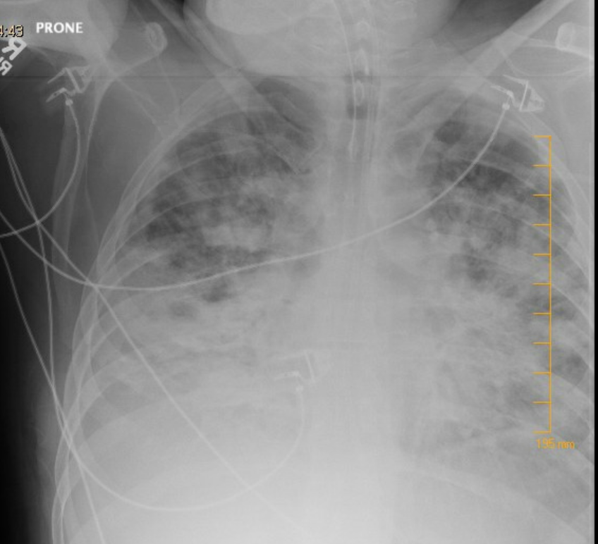
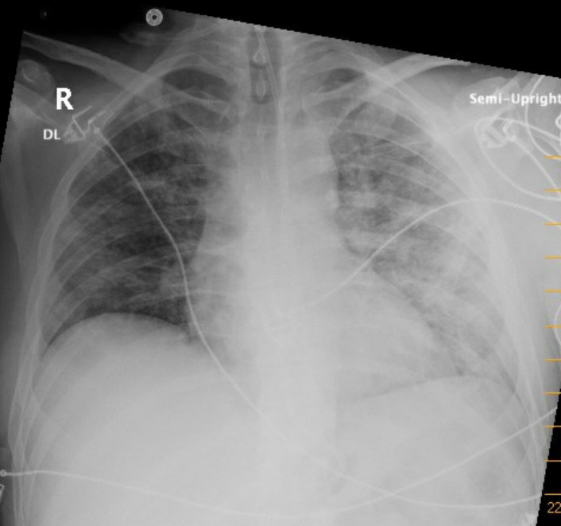
Case 2

Slide 24
Case 2
Usual ARDS care
Received hydroxychloroquine x 5 days
Extubated on day 14
ICU delirium
Eventually discharged to home on 4/16 (length of stay 26 days)
Covid testing remained positive on 4/15, most recent

Slide 25
Other Selected Cases
61 y/o F, no major comorbidities, positive on 3/20; admitted 3/22 – 3/26, minimal O2 requirements. Got HCQ x 5 days.
Follow up phone call 4/20 doing well, still with fatigue and mild nasal congestion. Covid testing remains positive, last checked 4/17.
Will follow up for plasma donation
28 y/o female with obesity, PCOS, recently placed on oral contraceptive. Admitted with acute hypoxia (on 2-4L O2), + Covid on 4/1, also with acute bilateral pulmonary emboli. Did well. Discharged 4/5.
Telehealth follow up last week, significantly improved
Declined hydroxychloroquine treatment in hospital
Treated PE with Xarelto
Will follow up for plasma donation

Slide 26
Other Selected Cases
69 y/o male with extensive PMH. Covid 19 + Legionella co-infection, ARDS, DKA, NSTEMI type II, renal failure. Expired after declining intubation, transitioned to inpatient hospice.
49 y/o male with DM, HTN, admitted 4/12 Covid +, completed 5 day course of hydroxychloroquine. Decompensated requiring intubation 4/19, CXR worsening, inflammatory markers up, IL6 = 83. Planning tocilizumab.
Multiple others with mild illnesses managed at home, or briefly on the medical floor.

Slide 27
MUHC Observational Data

Slide 28
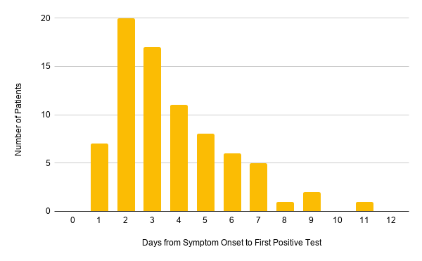
MUHC Observational Data
Time from symptom onset to first positive test
104 TOTAL PATIENTS
26 patient's symptoms were
unavailable or symptom onset date not
documented
2 patients were initially negative
(both 1 day after symptoms developed)
to later turn positive on days 3 and 8

Slide 29
MUHC Observational Data

Slide 30
MUHC Observational Data

Slide 31
Observations Disclaimer – my own thoughts
Hydroxychloroquine – no significant noticeable benefit in the patients we have seen, though these are case by case and not in the setting of a controlled clinical trial
Significant monitoring required with HCQ – G6PD, QTc, electrolytes; some patients have declined after discussion of risks vs unproven benefits and I often agree with them
Tocilizumab – Not sure yet, trialing my first dose this week
No experience with remdesivir, unable to obtain
If severe infection, patients require lengthy intubation and prolonged admission
Repeat testing is positive for a prolonged duration in many patients, even those with milder infections

Slide 32
Research
MUHC Covid research on the horizon:
HCQ prophylaxis for healthcare workers
Convalescent plasma donation
Compiling registry for patients diagnosed with HIV and Covid 19
We are working (very hard) to get serological testing, but not yet available

Slide 33
Convalescent Plasma Donation
Dima Dandachi, MD – MUHC Infectious Diseases, principal investigator
https://www.muhealth.org/conditions-treatments/coronavirus/plasma
Eligibility: Previously positive Covid 19 test, 14 days symptom free, with subsequent negative test
Working with Red Cross to obtain plasma from local donors to be used locally for patients with severe Covid 19 infection
Most patients are willing to donate if asked

